Slide 1
This slide is hidden.
Insert the starting slides after this slide

Slide 2
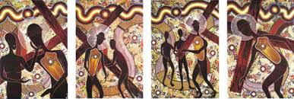
Welcome to St Michael’s
14th Sunday in Ordinary Time Year C
Please ensure all mobile phones are switched off.
Please be respectfully quiet as we prepare for our Celebration.
Today we celebrate Aboriginal and Torres Strait Islander Sunday
Notes:
Saturday 5.30PM First Sunday of Advent
7am - 7th Sunday in Ord Time Year B

Slide 3
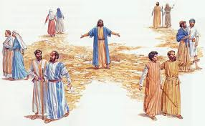
Jesus sent them out ahead of him in pairs to all the towns he was to visit ...

Slide 4
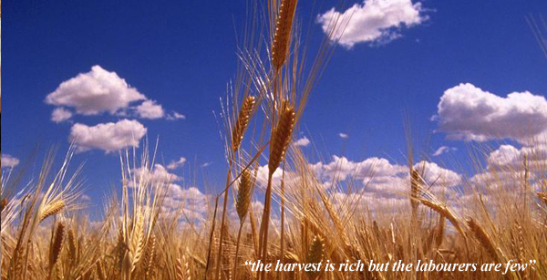
“The harvest is rich but the labourers few...”

Slide 5
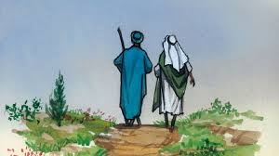
“Carry no purse, no haversack, no sandals ...”

Slide 6
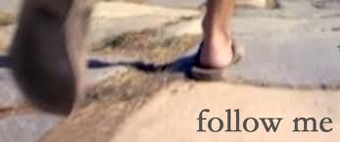
What is God asking of me and what is the next step in ʻdoing itʼ?

Slide 7
Please Stand

Slide 8
This slide is hidden.
Insert the Entrance Hymn after this slide

Slide 9
Gather as One
Amanda McKenna
Gather as one, Gather as one.
Gather all the people of God!
All of our days singing God's praise
Gather all the people as one

Slide 10
Gather as one, Gather as one.
Gather all the people of God!
All of our days singing God's praise
Gather all the people as one

Slide 11
We will sing a new song unto the Lord,
Of truth and beauty surrounding our God;
Of holiness and glory
Sing out to the Lord, all the earth!

Slide 12
Gather as one, Gather as one.
Gather all the people of God!
All of our days singing God's praise
Gather all the people as one

Slide 13
Gather all the nations unto the Lord.
Bring us together, our Lord and our God
And we will come rejoicing,
Proclaiming the Lord's holy name!

Slide 14
Gather as one, Gather as one.
Gather all the people of God!
All of our days singing God's praise
Gather all the people as one
Gather all the people as one

Slide 16
Kyrie eleison
Kyrie eleison (2)
Christe eleison (2)
Kyrie eleison (2)

Slide 18
Gloria
Glory to God in the highest,
and on earth peace to people of good will.
We praise you, we bless you,
we adore you, we glorify you,

Slide 19
We give you thanks for your great glory,
Lord, God heavenly king,
O God, almighty father

Slide 20
Glory to God in the highest,
and on earth peace to people of good will.

Slide 21
Lord Jesus Christ, Only Begotten Son,
Lord God, Lamb of God, Son of the Father,
you take away the sins of the world,
have mercy on us;

Slide 22
you take away the sins of the world, receive our prayer;
you are seated at the right hand of the Father,
have mercy on us.

Slide 23
Glory to God in the highest,
and on earth peace to people of good will.

Slide 24
For you alone are the Holy One,
you alone are the Lord,
you alone are the Most High, Jesus Christ,
with the Holy Spirit,
in the glory of God the Father.

Slide 25
Glory to God in the highest,
and on earth peace to people of good will.
Amen.

Slide 27
Responsorial Psalm
Let all the earth cry out to God with joy.

Slide 29
Alleluia
Alleluia, alleluia,
alleluia, alleluia

Slide 31
Apostles Creed
I believe in God,
the Father almighty,
Creator of heaven and earth,
and in Jesus Christ,
his only Son, our Lord,
(At the words that follow, up to and including the Virgin Mary, all bow.)

Slide 32
who was conceived by the Holy Spirit,
born of the Virgin Mary,
suffered under Pontius Pilate,
was crucified, died and was buried;
he descended into hell;

Slide 33
on the third day he rose again from the dead;
he ascended into heaven,
and is seated at the right hand of God the Father almighty;

Slide 34
from there he will come to judge the living and the dead.
I believe in the Holy Spirit,
the holy catholic Church,

Slide 35
the communion of saints,
the forgiveness of sins,
the resurrection of the body,
and life everlasting.
Amen.

Slide 37
First Collection
This collection goes to the Bishop
for the support of the Diocese.
Thank you for your contribution

Slide 39
This slide is hidden.
Insert the Offertory Hymn after this slide.

Slide 40
Blessed Be our God
Amanda McKenna
Take this bread,
Take this bread,
Gift and work of human hands.

Slide 41
Take this wine,
Take this wine,
From this branch of your vine.

Slide 42
Take our lives,
Take our lives
As an offering to you,
God of mercy,
Singing “Blessed be our God!”

Slide 43
Take this bread,
Take this bread,
Gift and work of human hands.

Slide 44
Take this wine,
Take this wine,
From this branch of your vine.

Slide 45
Take our lives,
Take our lives
As an offering to you,
God of mercy,
Singing “Blessed be our God!”

Slide 46
Take this bread,
Take this bread,
Gift and work of human hands.

Slide 47
Take this wine,
Take this wine,
From this branch of your vine.

Slide 48
Take our lives,
Take our lives
As an offering to you,
God of mercy,
Singing “Blessed be our God!”

Slide 50
Priest: Pray my brothers and sisters,
that my sacrifice and yours may be
acceptable to God, the almighty Father.
All: May the Lord accept the sacrifice
at your hands for the praise and glory of his name, for our good and the good of all his holy Church.

Slide 51
Priest: The Lord be with you.
All: And with your spirit.
Priest: Lift up your hearts.
All: We lift them up to the Lord.

Slide 52
Priest: Let us give thanks to the
Lord our God.
All: It is right and just.

Slide 54
Holy
Holy, Holy, Holy Lord God of hosts,
Heaven and earth are full of your glory. Hosanna in the highest
Blessed is he who comes
in the name of Lord,
Hosanna in the highest.

Slide 56
Memorial acclamation
Save us saviour of the world,
For by your cross and resurrection,
You have set us free

Slide 57
Memorial acclamation
When we eat this bread
And drink this cup
We proclaim your death O Lord
Until you come again

Slide 58
Memorial acclamation
Save us saviour of the world,
For by your cross and resurrection,
You have set us free

Slide 60
Amen
Amen, amen, amen, amen.
Amen, amen, amen, amen.

Slide 62
Priest: The Lord be with you.
All: And with your spirit

Slide 64
Peace
May the peace of the Lord be with you
With your friends and your family too
Let it be, let it grow
And everywhere you go
May the peace of the Lord follow you

Slide 65
Lamb of God
Lamb of God, lamb of God
You take away the sins of the world
Have mercy on us, lamb of God

Slide 66
Lamb of God, lamb of God
You take away the sins of the world
Have mercy on us, lamb of God

Slide 67
Lamb of God, lamb of God
You take away the sins of the world
Grant us, grant us peace

Slide 69
Priest: Behold the Lamb of God, behold him
who takes away the sins of the world.
Blessed are those called to the supper of the Lamb.
All: Lord, I am not worthy
that you should enter under my roof,
but only say the word
and my soul shall be healed.

Slide 70
This slide is hidden
Insert communion hymns after this slide

Slide 71
Jesus, Bread of Life
Amanda McKenna
Jesus, bread of life,
Cup of love poured out for us.
Jesus, lamb of God,
Holy one, gift of peace.

Slide 72
No one can live on bread alone,
But ev'ry word from the mouth of God

Slide 73
Jesus, bread of life,
Cup of love poured out for us.
Jesus, lamb of God,
Holy one, gift of peace.

Slide 74
This is my son, my beloved one.
He is my delight, listen to him.

Slide 75
Jesus, bread of life,
Cup of love poured out for us.
Jesus, lamb of God,
Holy one, gift of peace.

Slide 76
I am the bread of life
Amanda McKenna
I am the Bread of life broken for the world
I am the cup poured out for all
Those who believe in me will never die
I am the life of the world

Slide 77
I am the food that the world cannot give
The food and drink
For those who hunger and thirst
I am the bread sent from heaven
You will have eternal life

Slide 78
I am the Bread of life broken for the world
I am the cup poured out for all
Those who believe in me will never die
I am the life of the world

Slide 79
I am the word from the beginning with God
I am the word alive and with you now
I am the word made flesh among you
You will have eternal life

Slide 80
I am the Bread of life broken for the world
I am the cup poured out for all
Those who believe in me will never die
I am the life of the world

Slide 81
I am the truth the new law given in love
I am the way; my words are spirit and life.
I am mercy and forgiveness
You will have eternal life

Slide 82
I am the Bread of life broken for the world
I am the cup poured out for all
Those who believe in me will never die
I am the life of the world

Slide 83
I am your friend; I'll always walk with you
Don't be afraid, I gave my life for you
I will walk with you forever
You will have eternal life

Slide 84
I am the Bread of life broken for the world
I am the cup poured out for all
Those who believe in me will never die
I am the life of the world

Slide 85
Second Collection
What you contribute now
is for the support of our
parish and its mission.
Thank you for your generosity

Slide 86
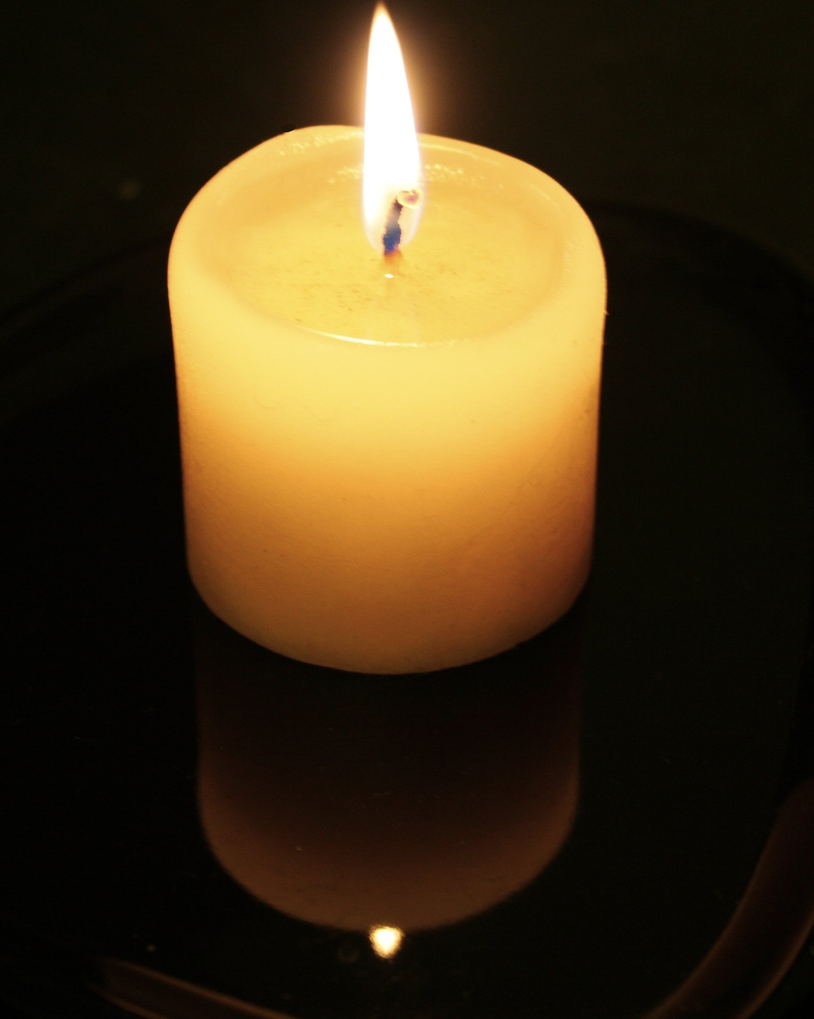
MEMORIAL MASS FOR
FATHER KEVIN DADSWELL
Saturday 13th July
8.00am Mass
ALL WELCOME

Slide 87
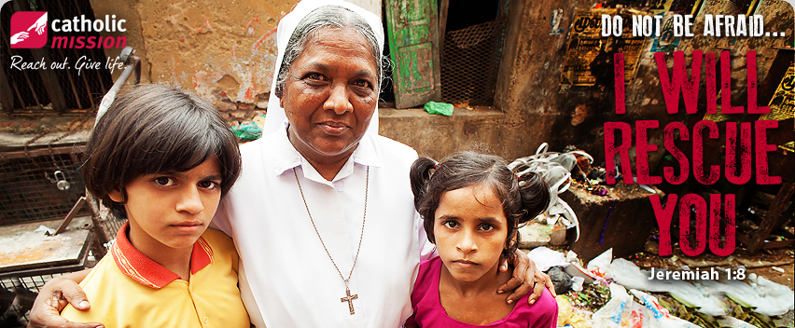
Special Collections
July 20/21: Catholic Mission “I Will Rescue You”
August 17/18: our Sister Parish in Myeik, Myanmar

Slide 88

Are you new to our Parish?
Speak with one of our priests;
Email the Parish Office
Write name and contact details on forms at church doors.
Notes:
7am - 7th Sunday in Ord Time Year B

Slide 89

Please take home your bulletins or download it from
www.stmichaelsparish.com
  www.facebook.com/
  blacktowncatholics

Slide 90
This slide is hidden.
The next slide can be used for videos.
Insert the video into the slide.

Slide 92
Priest: The Lord be with you.
All: And with your spirit.

Slide 94
Go tell everyone
God's spirit is in my heart
He has called me and set me apart
This is what I have to do
What I have to do

Slide 95
He sent me to bring the good news to the poor
Tell prisoners that they are prisoners no more
Tell blind people that they can see
And set the downtrodden free

Slide 96
And go tell everyone
The news that the kingdom of God has come
And go tell everyone
The news that God's kingdom has come

Slide 97
Just as the Father sent me
So I'm sending you out to be
My witnesses throughout the world
The whole of the world

Slide 98
He sent me to bring the good news to the poor
Tell prisoners that they are prisoners no more
Tell blind people that they can see
And set the downtrodden free

Slide 99
And go tell everyone
The news that the kingdom of God has come
And go tell everyone
The news that God's kingdom has come

Slide 100
What is God asking of me and what is the next step in ʻdoing itʼ?

